Slide 1
CUSTOMER
RETENTION
How can a company identify and retain its most valuable customers?
BIG DATA ANALYTICS & DBMS PROJECT
DATA → INSIGHT → ACTION
An RFM and Customer Segmentation Study of a UK Online Retailer
Akshith Kompelly | PGDM (Marketing)
Bhadruka School of Management, Hyderabad
Faculty: Dr. Buchi Babu Muvva • October 2026

Slide 2
1. Business Problem
Why customer segmentation matters
THE CHALLENGE
THE BUSINESS QUESTION
• The retailer has thousands of transactions but no clear prioritisation of customers.
• Marketing effort spent equally across all customers can waste budget.
• High-value customers may quietly stop buying without timely follow-up.
Who brings the most value, who is drifting away, and what should we do for each group?
Goal: use transaction data to make retention more focused and evidence-based.
Customer Retention & RFM Analysis | PGDM Marketing
02

Slide 3
2. Dataset & Preparation
Public UCI Online Retail data, covering Dec 2010 to Dec 2011
541,909
391,150
4,334
18,402
Raw transaction lines
Rows after cleaning
Identifiable customers
Valid invoices
Main cleaning steps
• Remove rows without CustomerID and cancellation invoices.
• Exclude non-positive quantity/price and non-product stock codes.
• Remove exact duplicates; use the same rules in SQL, Python and Databricks.
Note: revenue is gross revenue and is not the same as profit.
Customer Retention & RFM Analysis | PGDM Marketing
03

Slide 4
3. Tools & Workflow
Each tool has a clear job in the analytics pipeline
01
02
03
04
05
PostgreSQL
DBeaver / SQL
Python
Databricks
Power BI
→
→
→
→
Store raw and cleaned data in related tables
Clean, join, aggregate and calculate RFM scores
Profile data, chart trends and validate retention
Repeat processing with PySpark and save Delta tables
Present KPIs and segment insights for decisions
Same cleaning rules and RFM definitions help keep results consistent across tools.
Customer Retention & RFM Analysis | PGDM Marketing
04

Slide 5
4. Method: RFM Segmentation
A simple way to understand customer value and buying behaviour
R
F
M
RECENCY
FREQUENCY
MONETARY
How recently did the customer buy?
How many valid invoices did they place?
How much did they spend?
More recent = better
More orders = stronger habit
Higher spend = more revenue
Customers receive scores from 1 to 5, then are assigned to six practical segments.
Customer Retention & RFM Analysis | PGDM Marketing
05

Slide 6
5. Key Findings
Revenue is concentrated among a relatively small group of customers
64.6%
81.5%
40.0%
Revenue from Champions
Revenue from Champions + Loyal
Customers At Risk or Lost
941 customers | £5.65m
44.9% of customers
1,734 customers
Segment
Customers
Revenue share
Goal
Champions
941
64.6%
Protect
Loyal
1,006
16.9%
Grow
At Risk
653
9.2%
Win back
Lost
1,081
5.9%
Low-cost reactivation
Needs Attention
345
1.8%
Nudge
New / Promising
308
1.5%
Convert
Customer Retention & RFM Analysis | PGDM Marketing
06

Slide 7
6. Validation: Do Segments Mean Anything?
Customers were scored up to August 2011, then later purchases were checked
Champions
89.1%
Loyal
64.9%
At Risk
53.3%
New / Promising
48.1%
Needs Attention
45.1%
Lost
36.2%
Champions were about 2.5× as likely to buy again as Lost customers.
This supports prioritisation, but does not prove a campaign will cause higher retention.
Customer Retention & RFM Analysis | PGDM Marketing
07

Slide 8
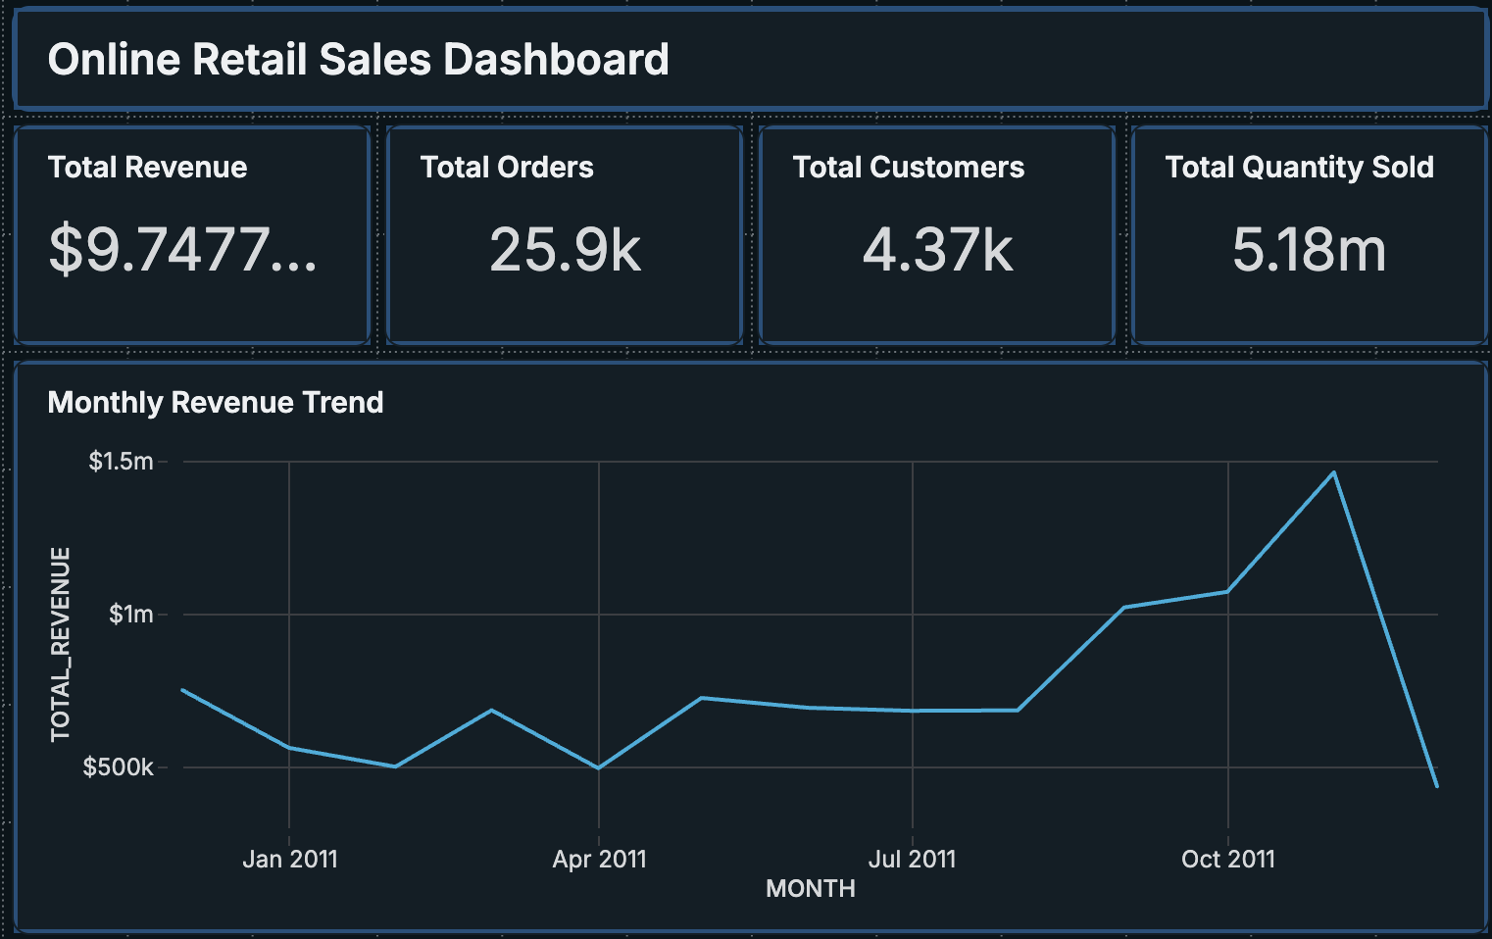
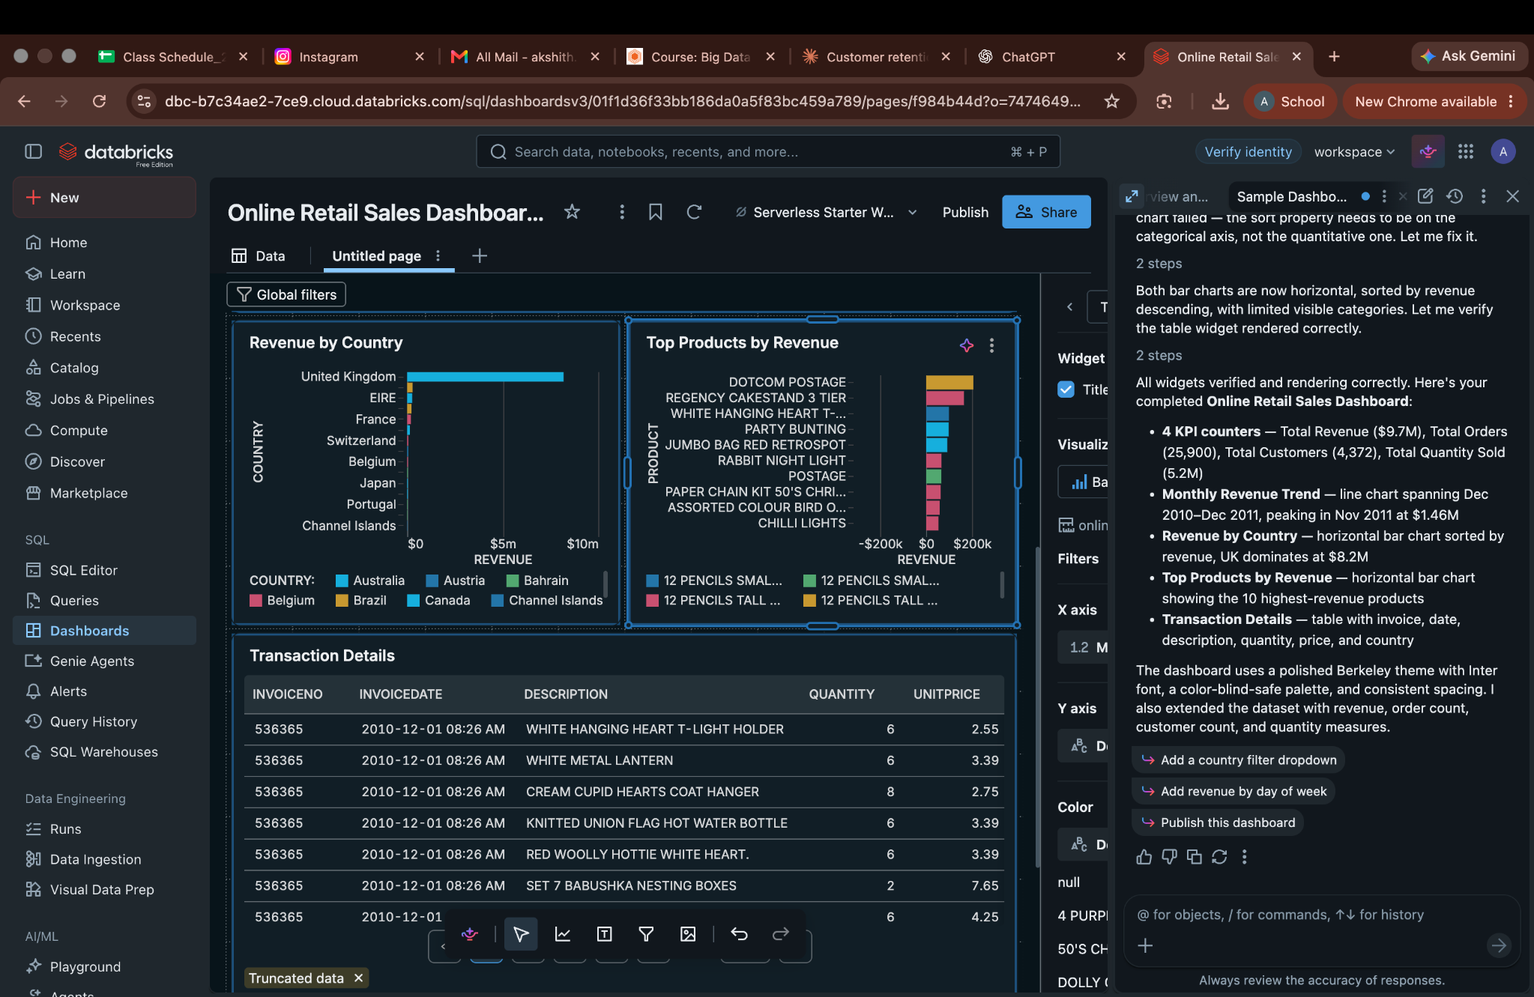
7. Databricks Dashboard Evidence
Both screenshots supplied for the project are included below
Dashboard 1 | KPI cards + monthly revenue
Dashboard 2 | Databricks workspace + charts + transaction table
Note: first image shows headline KPIs and monthly trend; second shows the Databricks dashboard page with country/product charts and transaction details.
Customer Retention & RFM Analysis | PGDM Marketing
08

Slide 9
8. Recommended Retention Actions
Use a different action for each segment instead of one campaign for everyone
Champions
Loyal
Reward loyalty, early access, and personal account contact.
Cross-sell based on purchase history and encourage larger baskets.
New / Promising
At Risk
Send a second-purchase offer within 30 days.
Contact high-value accounts personally and ask why they stopped.
Lost
Needs Attention
Use one low-cost win-back message; limit spend if there is no response.
Send timely reminders and relevant product recommendations.
Customer Retention & RFM Analysis | PGDM Marketing
09

Slide 10
9. Conclusion & Next Steps
Turn analysis into a measurable retention programme
WHAT WE LEARNED
NEXT STEPS
• RFM helps identify the most valuable and inactive customers.
• Champions generate a large share of revenue and deserve protection.
• The holdout test shows clear differences in later buying behaviour.
• Databricks provides a repeatable Spark and Delta workflow.
• Net cancellations against original orders.
• Add cost and margin data to analyse profit, not only revenue.
• Run a controlled campaign for high-value At Risk customers.
• Track 90-day repeat purchase and segment movement.
Important limitation: one year of data, partial December, and two cancelled large orders included in gross revenue.
Customer Retention & RFM Analysis | PGDM Marketing
10

